Slide 1
Agenda for GEOG260/360 GIS & Land Change Models
October 18
Get instructions for Assignment 7
October 23
Discuss Assignment 7
October 25
Submit Assignment 7 by 4pm on Canvas
Get instructions for Assignment 8
October 30
Discuss Assignment 8
November 1
Submit Assignment 8 by 4pm on Canvas
Get instructions for Project Proposal

Slide 2
Assignment 7
Perform two runs with LCM. Earlier time image is 1971ForestOtherBuilt. Later time image is 1985ForestOtherBuilt. Group all transitions into one sub-model. Independent variable is distance to 1971 Built as defined by 1971ForestOtherBuilt1. First run uses variable with Role as Static. Second run uses variable with Role as Dynamic with Basis Land Cover as built. Both runs use logistic regression without sampling. Allocate change to predict the year 2085 using the Markov matrix where the forest row is 0.6, 0.2, 0.2; Other row is 0.0, 0.6, 0.4; Built row is 0.0, 0.0, 1.0. Use 2 stages. Use Zoning - Constraints/Incentives with elevation01 for the three transitions. Submit 6 slides according to the instructions below.
Slide 1 is title slide.
Slide 2 gives your calculation of the number of pixels of the three positive transitions and the three categories of persistence from 1985 to 2085 according to your understanding of the Markov matrix, not necessarily according to the LCM output.
Slide 3 shows a CROSSTAB map of the simulated change from 1985 to 2035 for each of the two runs. Report the number of pixels for each transition for each run. For each run, compare the average transition potential value for the pixels that transitioned from Forest to Other with the average transition potential value for the pixels that transitioned from Forest to Built. Explain the reason for the results of the comparison.
Slide 4 shows a CROSSTAB map of the simulated change from 2035 to 2085 for each of the two runs. Report the number of pixels for each transition for each run. For each run, compare the average transition potential value for the pixels that transitioned from Forest to Other with the average transition potential value for the pixels that transitioned from Forest to Built. Explain the reason for the results of the comparison.
Slide 5 shows a CROSSTAB map of the simulated change from 1985 to 2085 for each of the two runs. Report the number of pixels for each transition for each run.
Slide 6 describes for each run whether the number of pixels of change from 1985 to 2085 equals sum of the changes during the two stages. If not equal, then explain why. Which of the runs (if any) match the number of pixels you computed in slide 2? If either run does not correspond, then explain why.

Slide 3
Rubric for assignment 7
Submit exactly one slide with your name(s). 5 points
Submit exactly one slide that shows the calculation of the number of pixels for the following bullets: 10 points
The three transitions. 5 points
The three persistence categories from 1985 to 2085. 5 points
Submit exactly one slide which includes the following bullets: 25 points
CROSSTAB maps of the simulated change from 1985 to 2035 for each of the two runs. 10 points
Report the number of pixels for each transition for each run. 5 points
Compare the average transition potential value for the pixels that transitioned from Forest to Other with the average transition potential value for the pixels that transitioned from Forest to Built for each run. 5 points
Explain the reason for the results of the comparison. 5 points
Submit exactly one slide which includes the following bullets: 25 points
CROSSTAB maps of the simulated change from 2035 to 2085 for each of the two runs. 10 points
Report the number of pixels for each transition for each run. 5 points
Compare the average transition potential value for the pixels that transitioned from Forest to Other with the average transition potential value for the pixels that transitioned from Forest to Built for each run. 5 points
Explain the reason for the results of the comparison. 5 points
Submit exactly one slide which includes the following bullets: 15 points
CROSSTAB maps of the simulated change from 1985 to 2085 for each of the two runs. 10 points
Report the number of pixels for each transition for each run. 5 points
Submit exactly one which includes the following bullets: 15 points
Describe for each run whether the number of pixels of change from 1985 to 2085 equals the sum of the changes during the two stages. If not equal, then explain why. 5 points
Which of the runs (if any) match the number of pixels you computed in slide 2? 5 points
If either run does not correspond, then explain why. 5 points
Bonus. 5 points

Slide 4
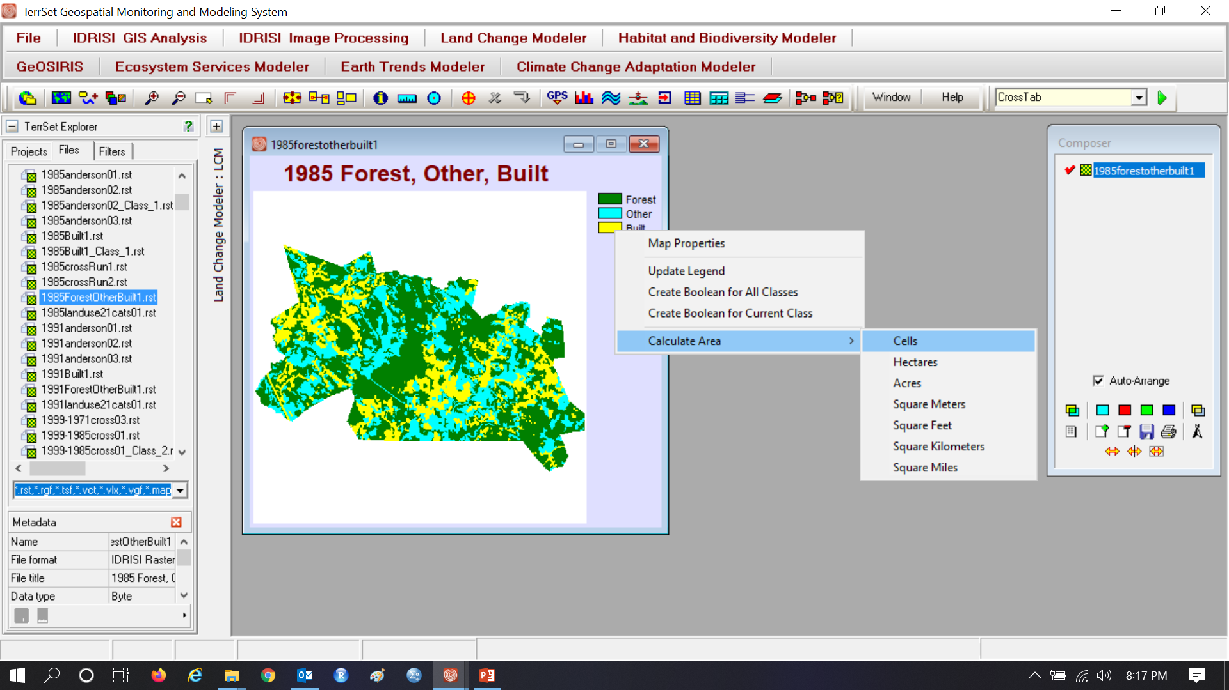
Assignment 7

Slide 5
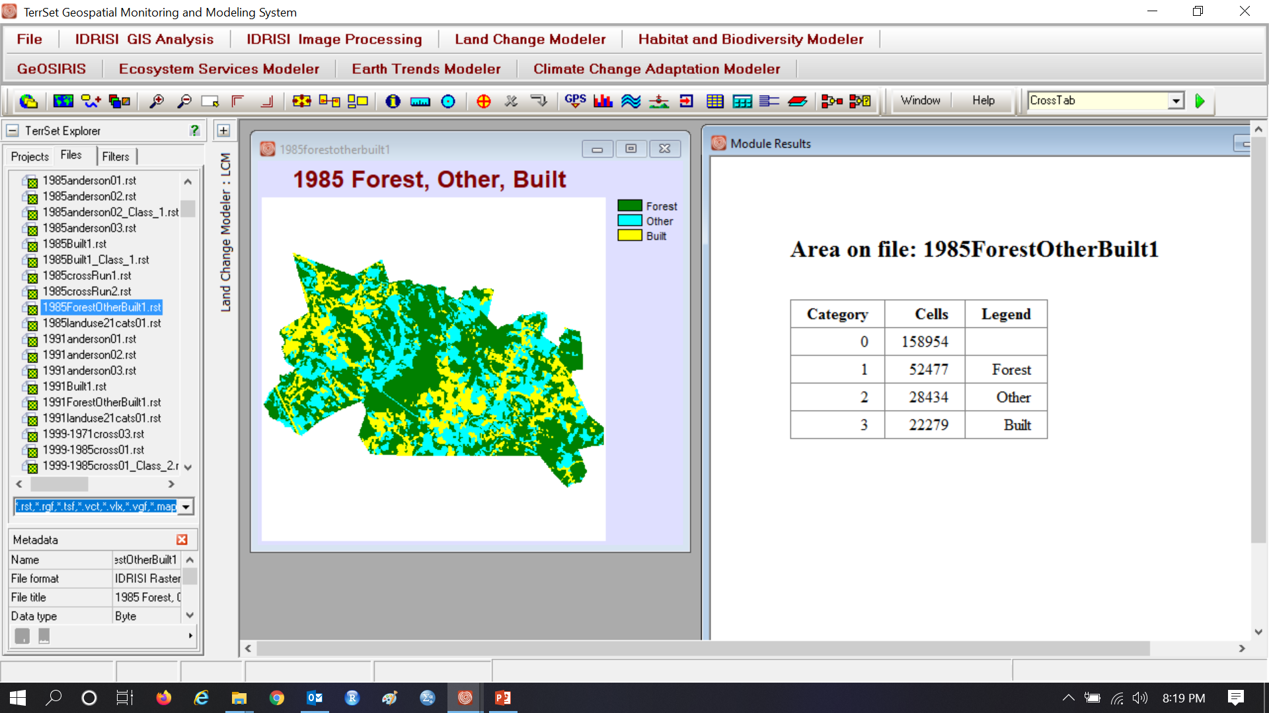
Assignment 7

Slide 6
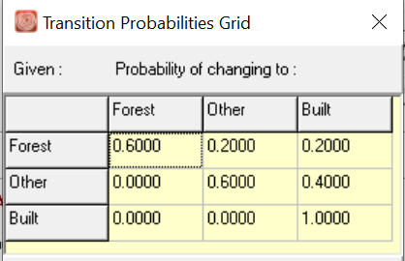
Assignment 7
1 | 52477 | Forest
2 | 28434 | Other
3 | 22279 | Built
 |  | 2085 | 2085 | 2085
 |  | Forest | Other | Built | Sum
1985 | Forest | 0.6*52477 = 31486.2 | 0.2*52477=10495.4 |  | 52477
1985 | Other |  |  |  | 28434
1985 | Built |  |  |  | 22279
 | Sum |  |  |  | 103190

Slide 7
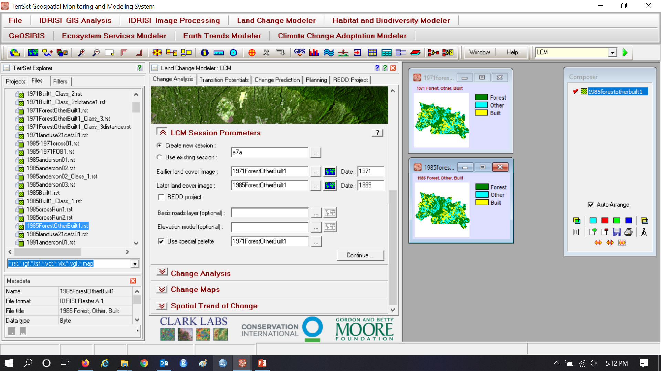
Assignment 7

Slide 8
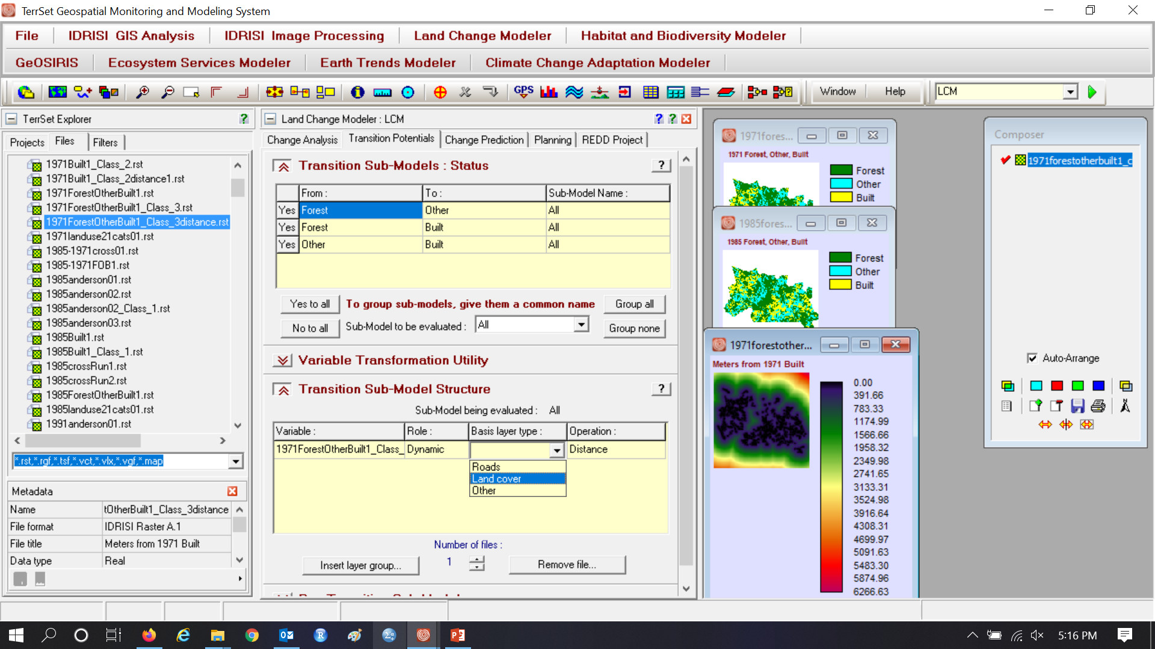
Group all, Variable is Distance to 1971 Built. First run has Role as Static.

Slide 9
Group all, Variable is Distance to 1971 Built, Second Run has Role as Dynamic, Basis is Land Cover

Slide 10
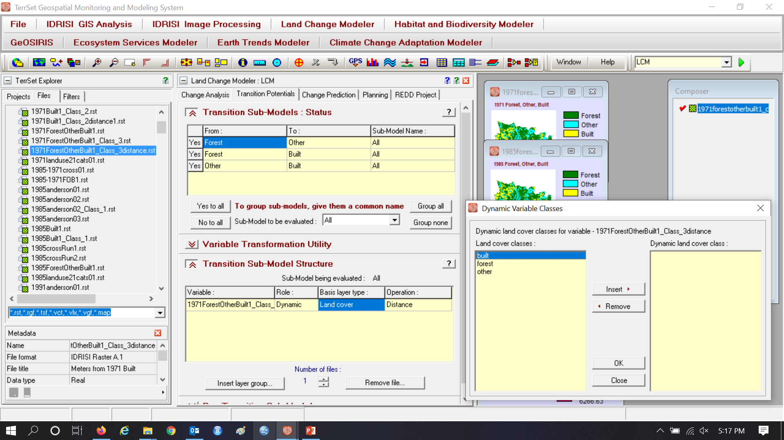
Basis is Land Cover built for second run

Slide 11
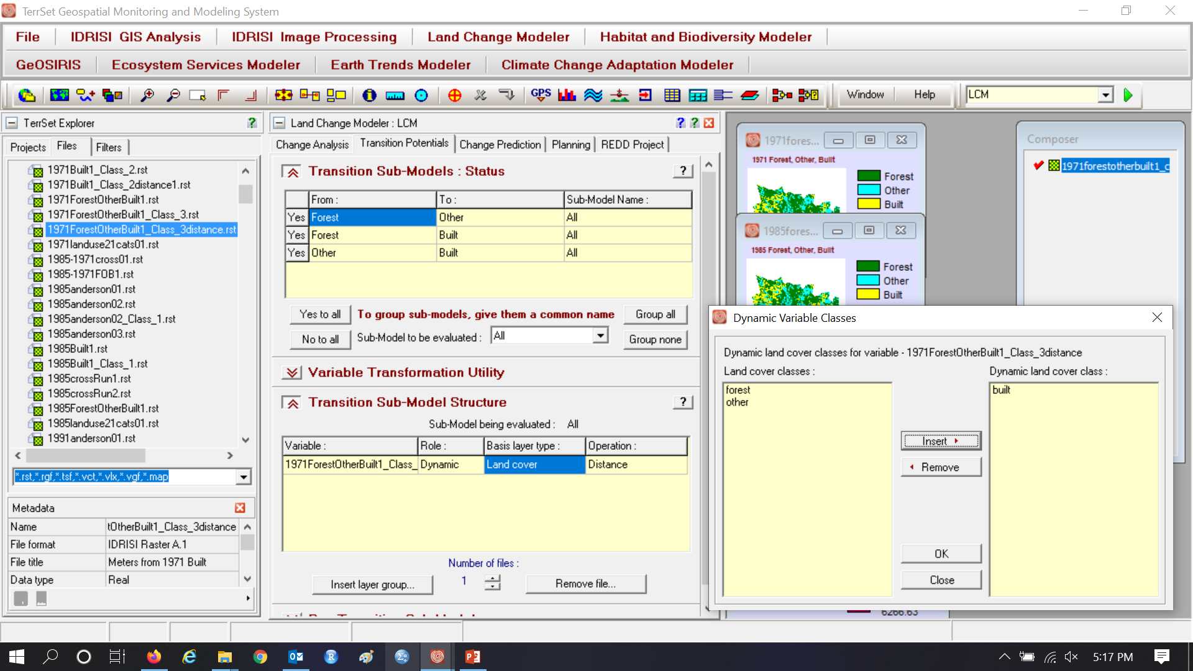
Basis is Land Cover built for second run

Slide 12
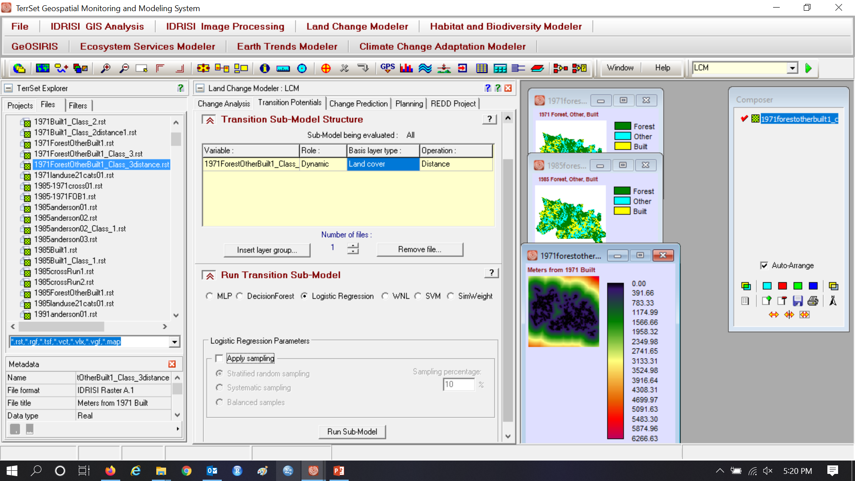
Basis Layer type: Land cover for second run

Slide 13
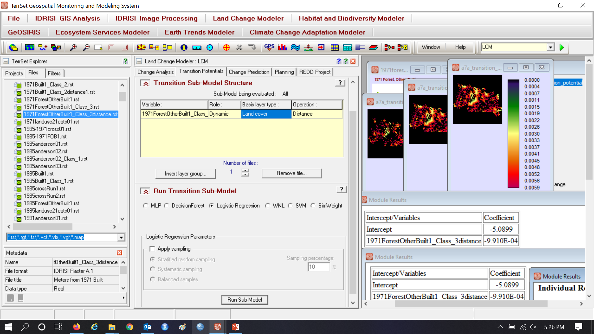
Logistic Regression without Sampling

Slide 14
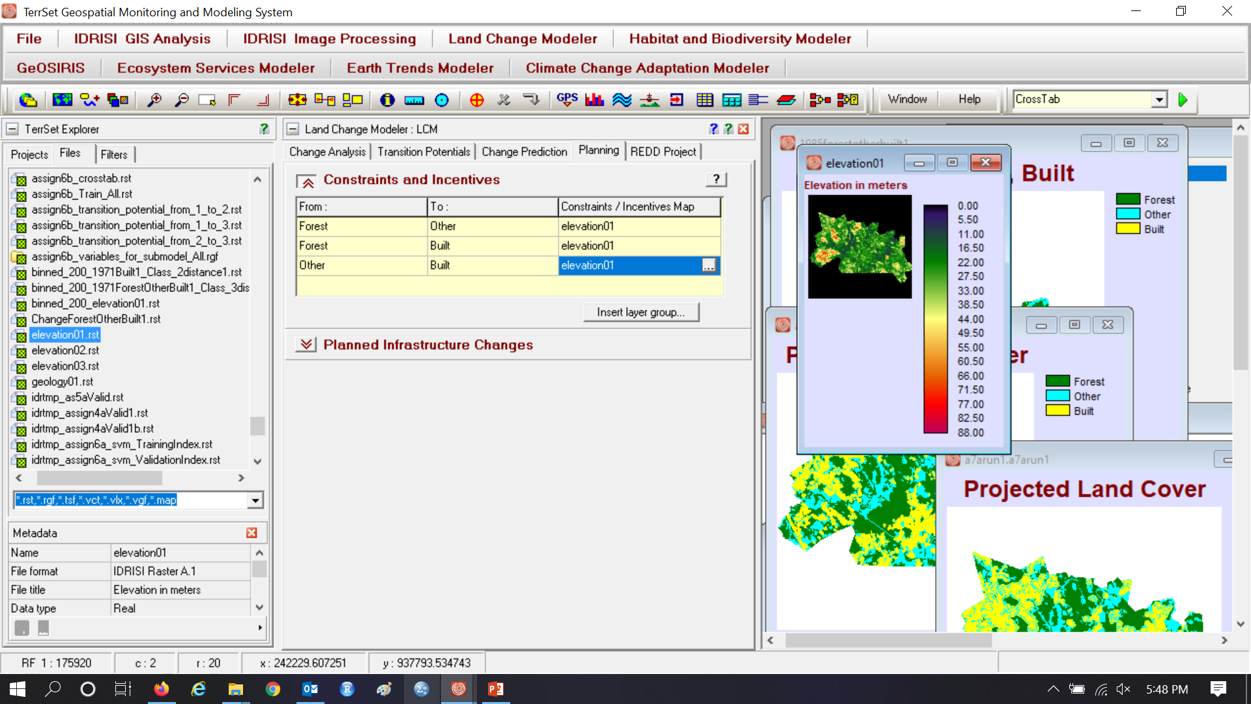
Put elevation in Planning Tab to give incentive to allocate change on high elevations

Slide 15
Make an incentive to build on higher elevations

Slide 16
Assignment 7 using Logistic Regression Soft

Slide 17
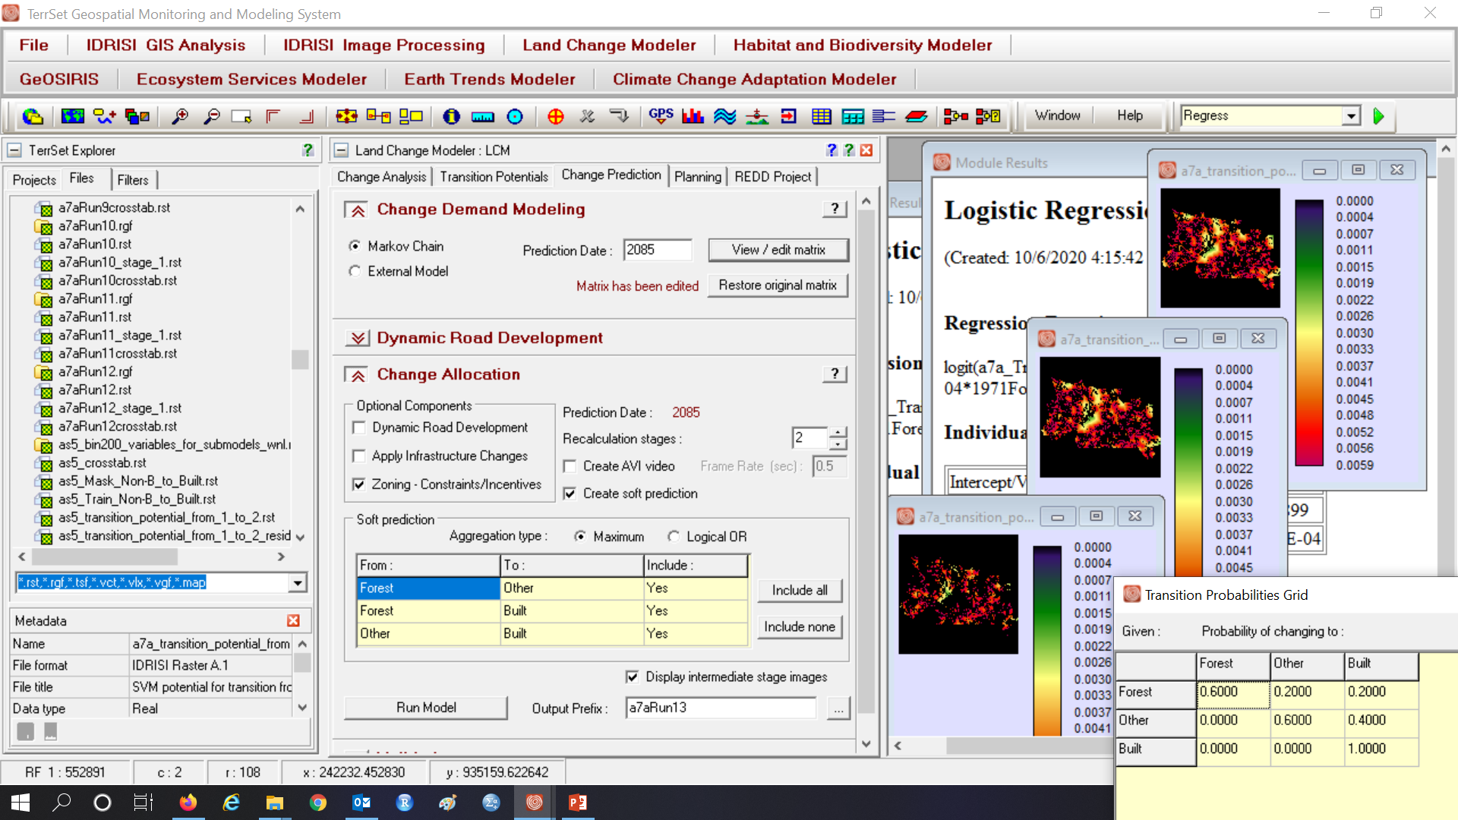
Simulate to 2085 with and edited Markov matrix

Slide 18
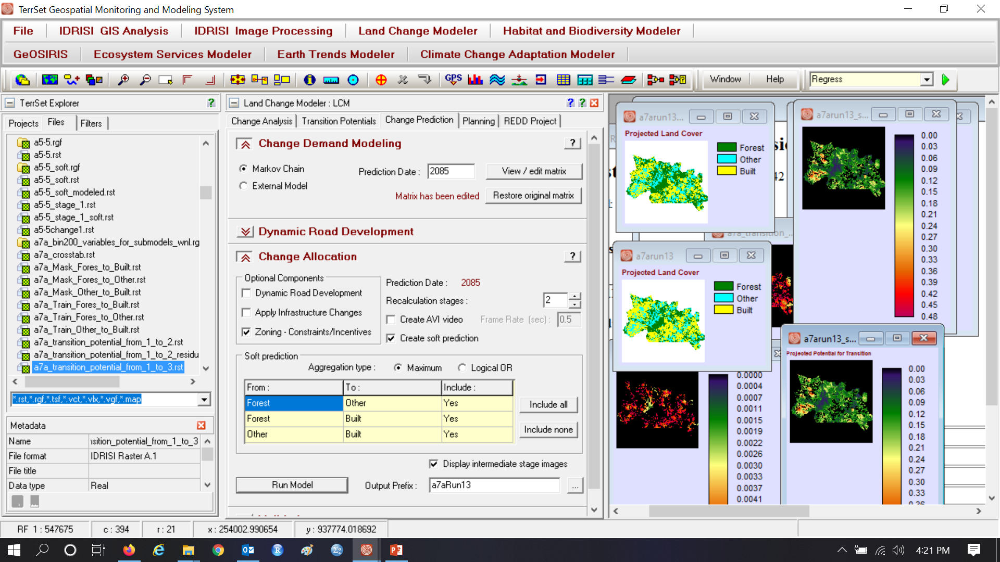
Assignment 7 gives output for two 50-year stages

Slide 19
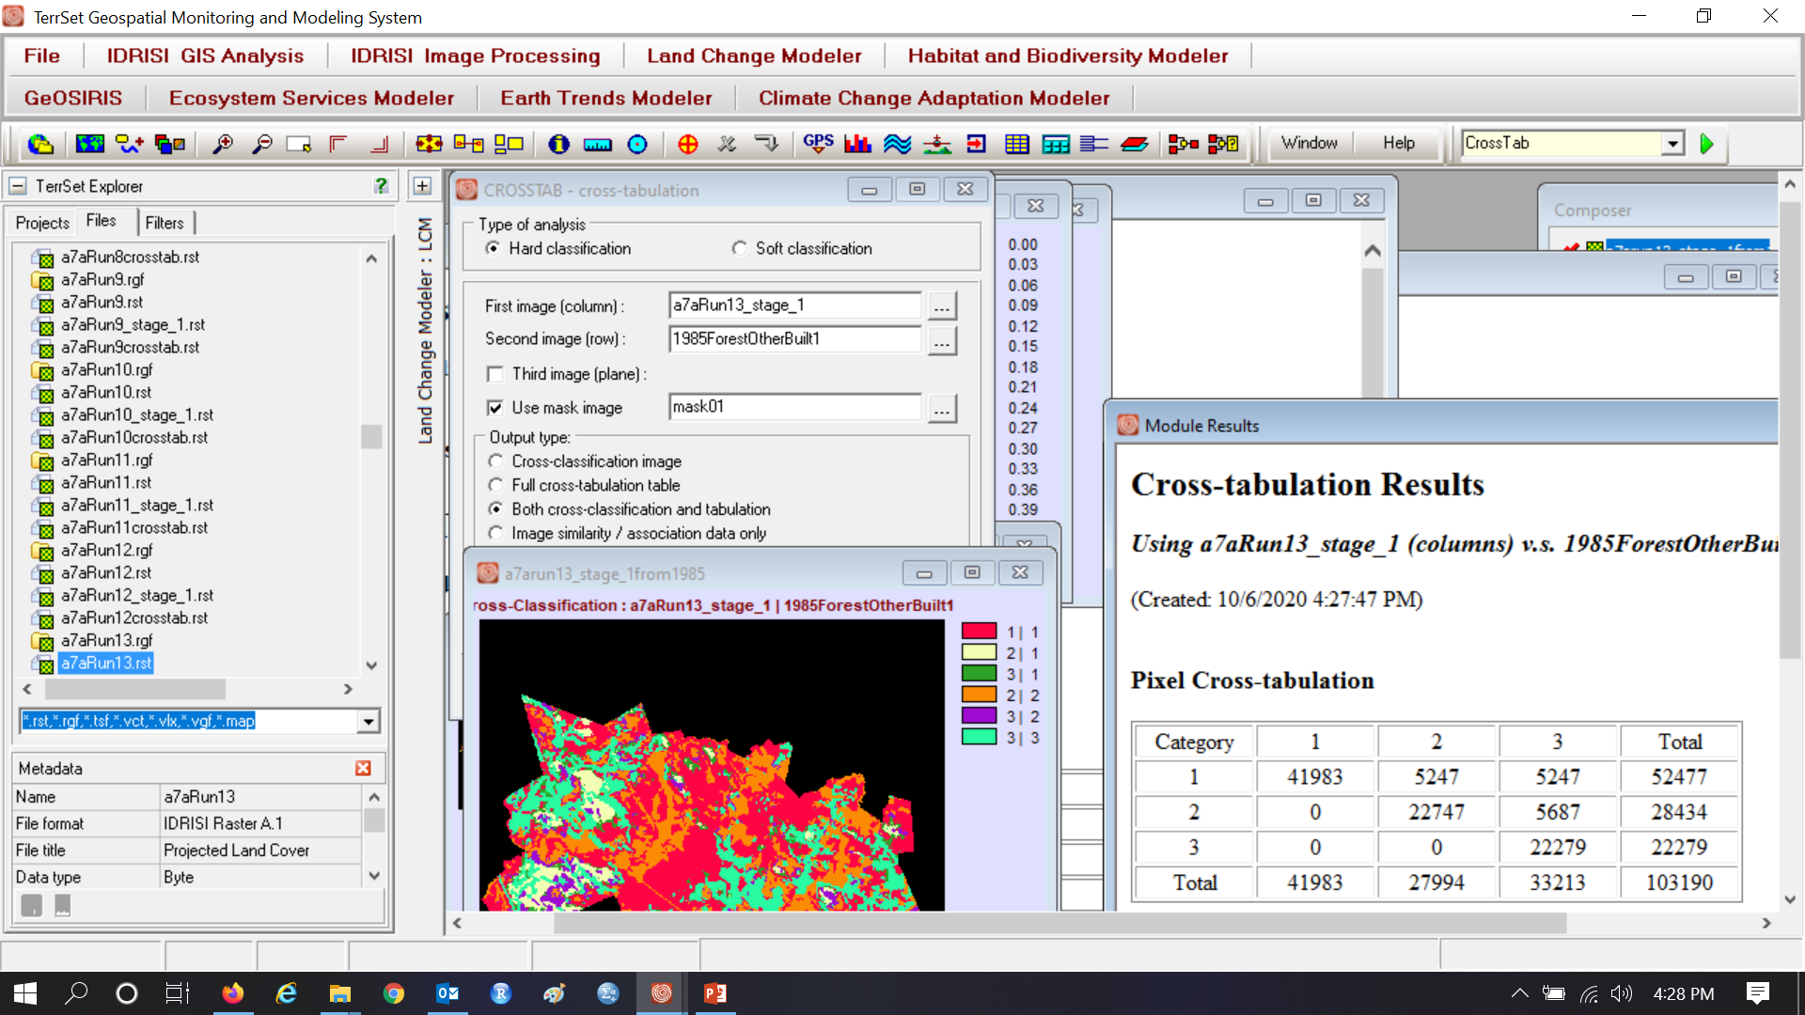
Assignment 7 using Logistic Regression 1985-2035

Slide 20

Assignment 7 using Logistic Regression 2035-2085

Slide 21
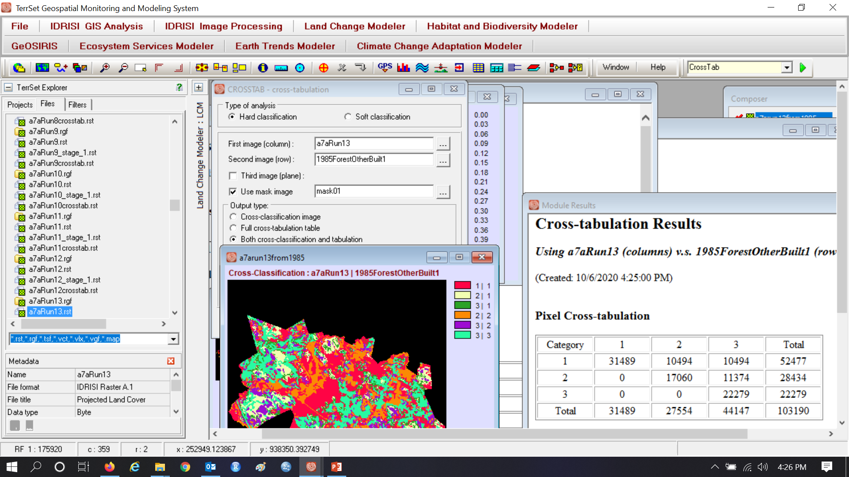
Is the Markov computation verified when using Logistic Regression with static variable?

Slide 22
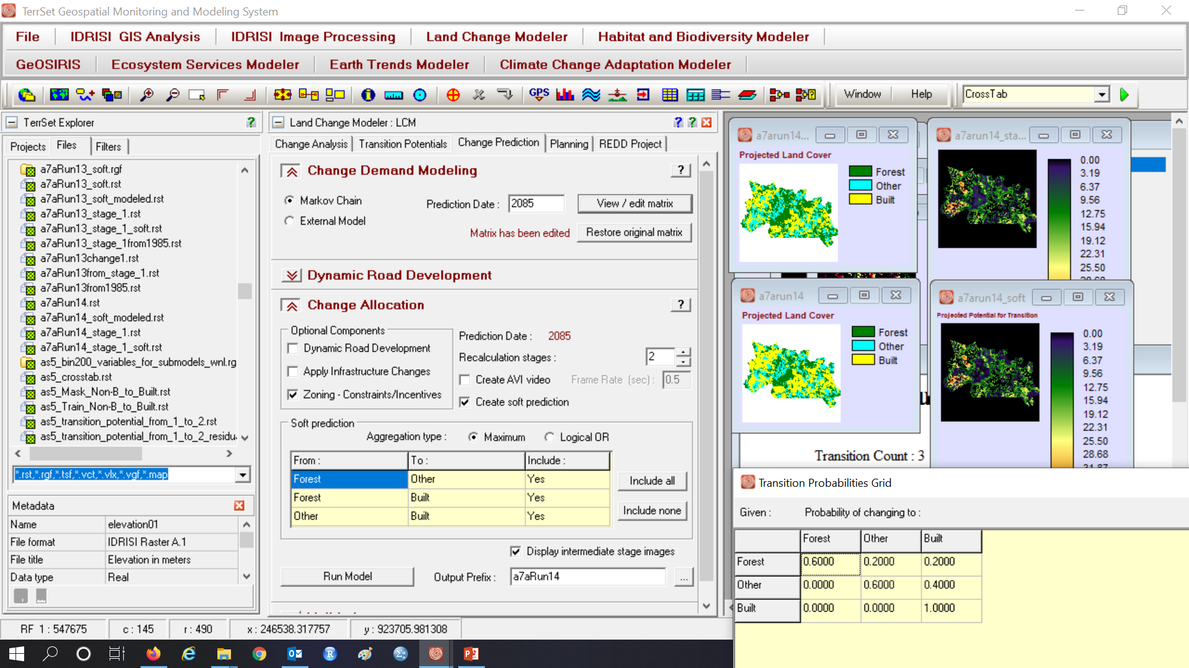
Assignment 7 gives output for two 50-year stages

Slide 23
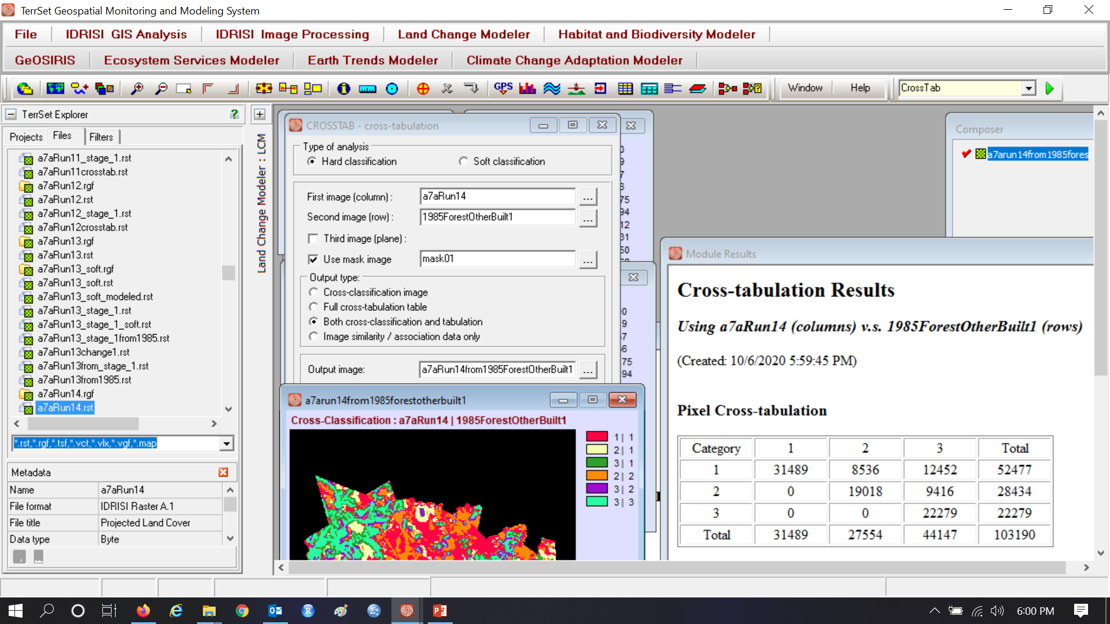
Is the Markov computation verified when using distance as a dynamic variable? Why is there a difference in output between using the distance variable as static variable versus dynamic? How can we unravel the riddle?

Slide 24
Compare the transition potential maps for the transitions from Forest to Other and from Forest to Built. If the transition potential maps for these two transitions are identical, then how does LCM decide whether a particular Forest pixel transitions to Other or Built?

Slide 25
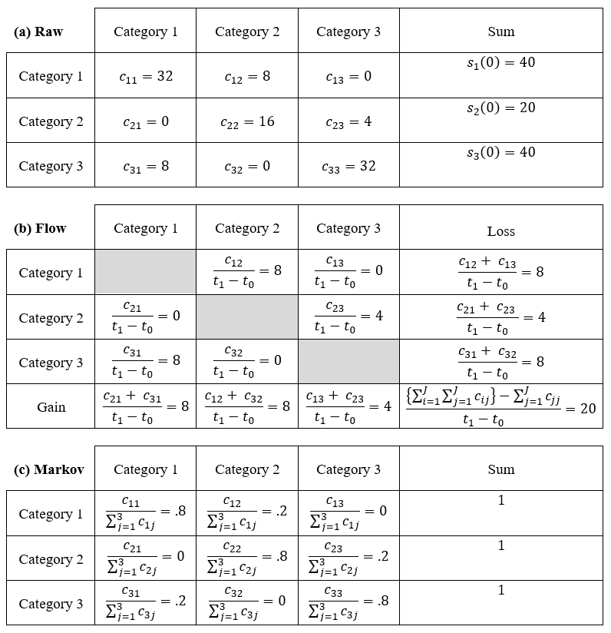
Flow versus Markov Extrapolation
Raw data are the source of the calculation for both Flow and Markov matrices. Both matrices extrapolate beyond the second time point of the Raw data.
Flow matrix assumes each transition has a constant size per time during the extrapolation through continuous future time.
Markov assumes each transition is a constant proportion of the losing category at the start of each time interval across incremental steps of future time.

Slide 26
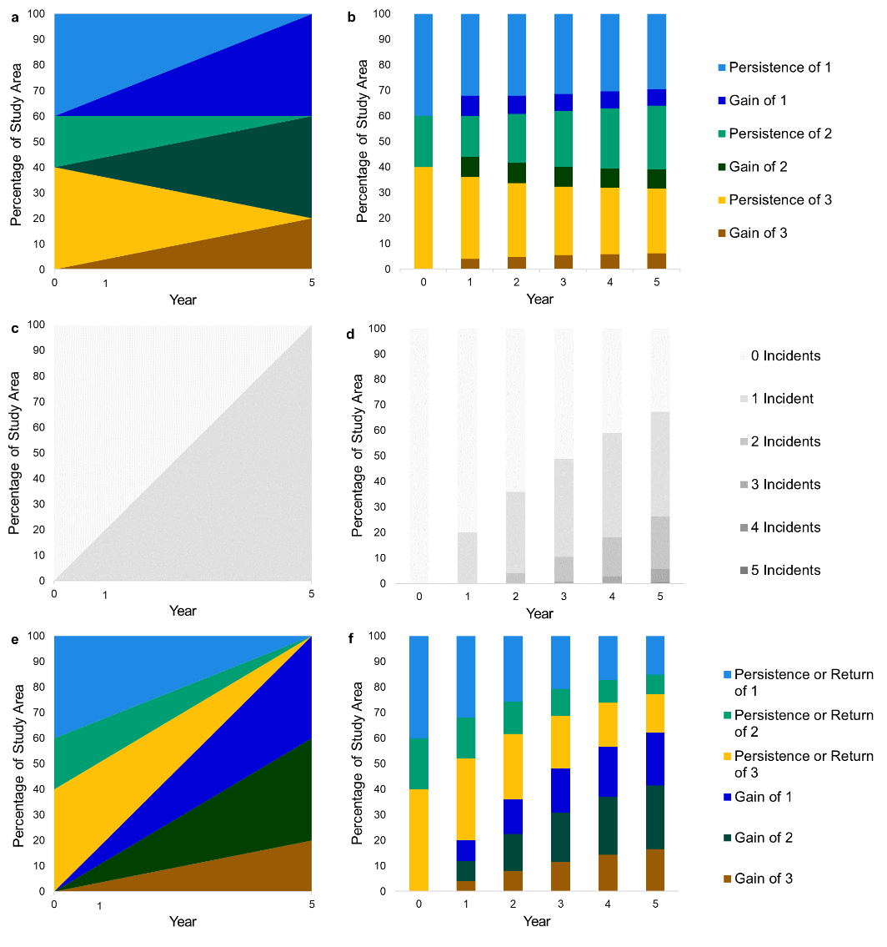
Flow versus Markov Extrapolation
The three graphs in the left column show the Flow extrapolation while the three graphs in the right column show the Markov extrapolation from a calibration interval that starts at year 0 and ends at year 1. One legend applies to each pair of graphs. The upper pair shows the size of each category via (a) Flow and (b) Markov, where Markov shows transitions from the preceding year. The middle pair shows the cumulative number of incidents via (c) Flow and (d) Markov. The lower pair shows change in the bottom three segments via (e) Flow and (f) Markov, where Markov shows differences from year 0.

Slide 27
Flow versus Markov Extrapolation
Flow extrapolation is continuous. Markov extrapolation is in discrete steps.
Flow changes a pixel at most once. Markov can change any pixel at each step.
Flow give constant change per time. Markov tends to show change decelerating.
Flow ends when persistence is 0. Markov never ends.

Slide 28
Flow versus Markov Extrapolation
Flow extrapolation is continuous. Markov extrapolation is in discrete steps.
Flow changes a pixel at most once. Markov can change any pixel at each step.
Flow give constant change per time. Markov tends to show change decelerating.
Flow ends when persistence is 0. Markov never ends.

Slide 29
Top of dark blue shows change from time 0.
Flow extrapolation is continuous. Markov extrapolation is in discrete steps.
Flow changes a pixel at most once. Markov can change any pixel at each step.
Flow give constant change per time. Markov tends to show change decelerating.
Flow ends when persistence is 0. Markov never ends.

Slide 30
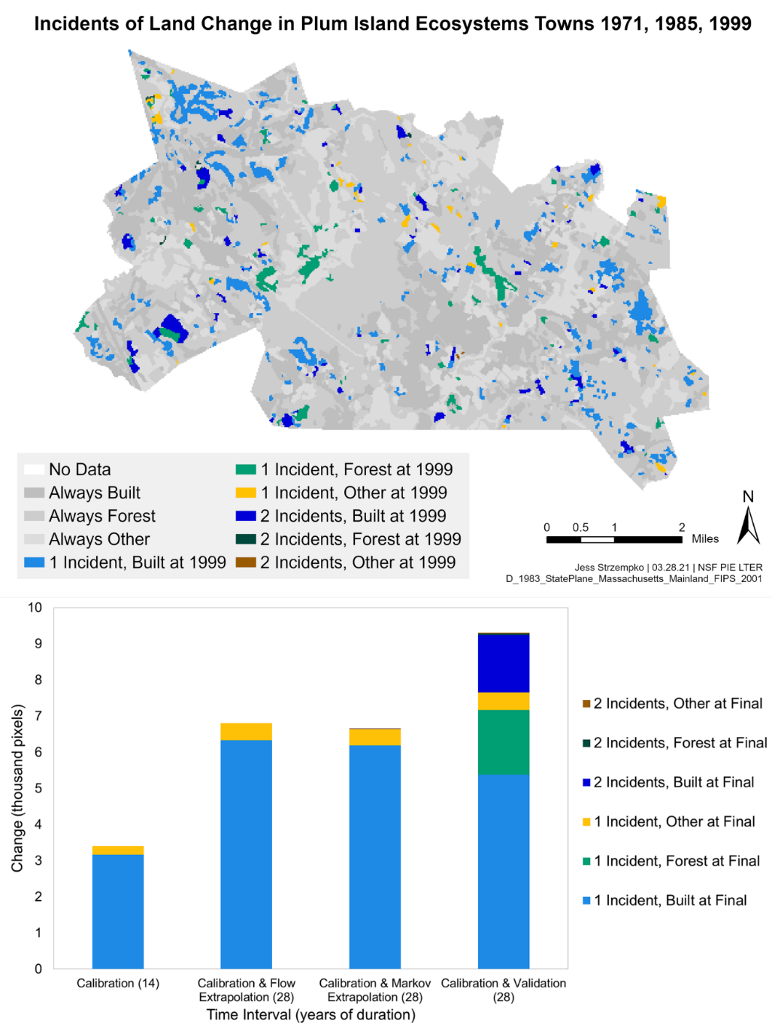
Both matrices are slower than the real suburban change
Bars show cumulative number incidents since start of calibration interval along with the category at the end of the second time interval for categories Built, Forest, and Other.

Slide 31
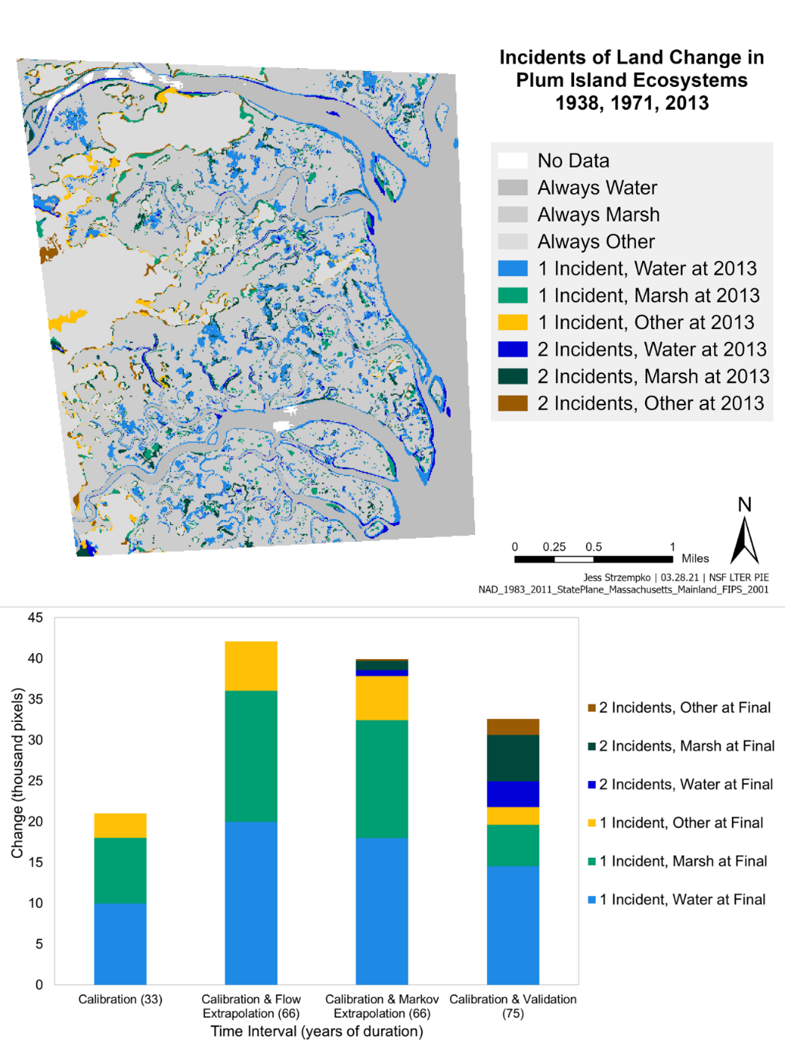
Both matrices are faster than the real wetland change
Bars show cumulative number incidents since start of calibration interval along with the category at the end of the second time interval for categories Marsh, Water, and Other.

Slide 32
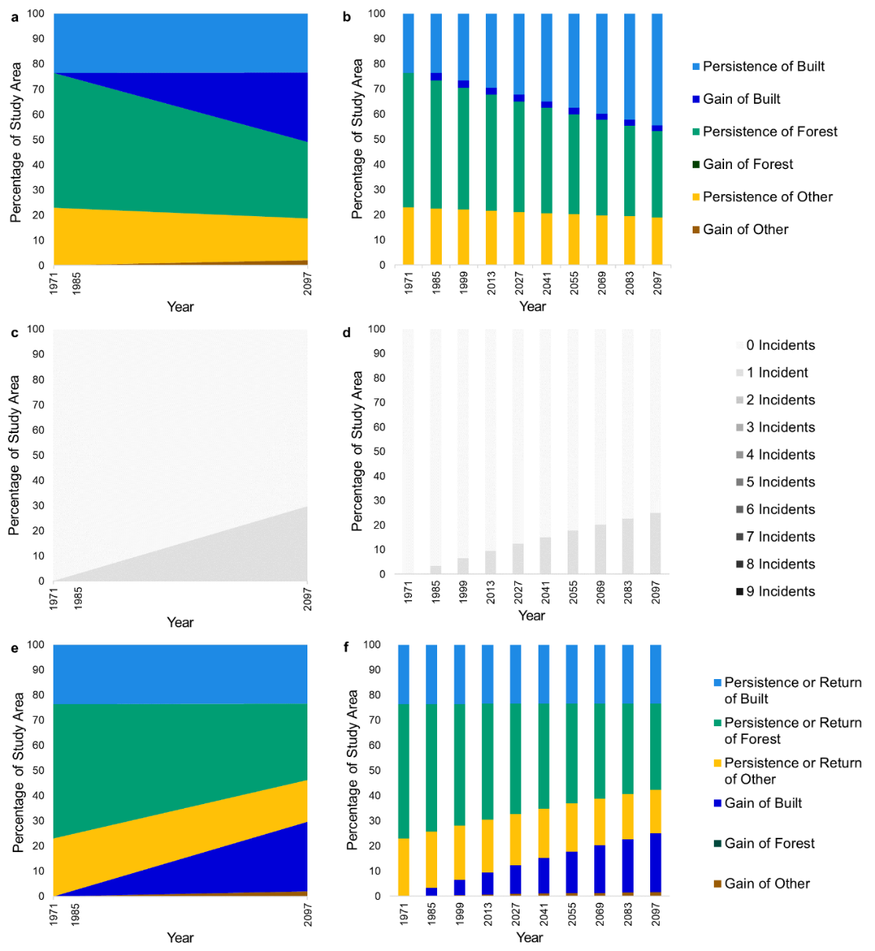
Plum Island Ecosystems Towns extrapolated to 2007
Flow shows constant speed of change.
Markov shows decelerating speed of change.
The three graphs in the left column show the Flow extrapolation while the three graphs in the right column show the Markov extrapolation from a calibration interval that starts at 1971 and ends at 1985. One legend applies to each pair of graphs. The upper pair shows the size of each category via (a) Flow and (b) Markov, where each Markov bar shows transitions from 14-years previous. The middle pair shows the cumulative number of incidents via (c) Flow and (d) Markov. The lower pair shows change in the bottom three segments via (e) Flow and (f) Markov, where Markov shows differences from 1971.

Slide 33
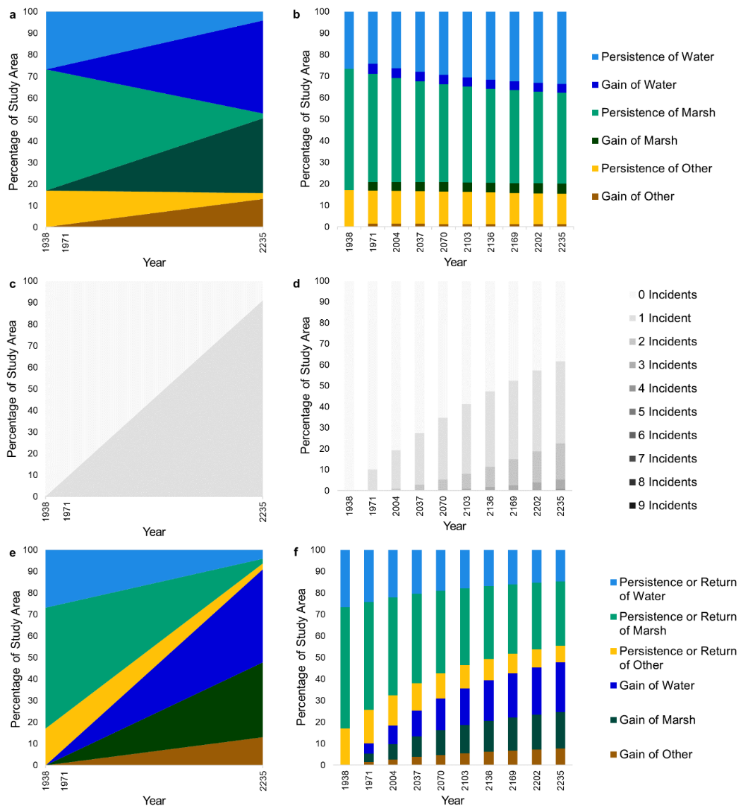
Plum Island Ecosystems Wetland extrapolated to 2235
Flow shows constant speed of change.
Markov shows decelerating speed of change.
The three graphs in the left column show the Flow extrapolation while the three graphs in the right column show the Markov extrapolation from a calibration interval that starts at 1938 and ends at 1971. One legend applies to each pair of graphs. The upper pair shows the size of each category via (a) Flow and (b) Markov, where each Markov bar shows transitions from 33-years previous. The middle pair shows the cumulative number of incidents via (c) Flow and (d) Markov. The lower pair shows change in the bottom three segments via (e) Flow and (f) Markov, where Markov shows differences from 1938.

Slide 34
Flow versus Markov Extrapolation
Characteristic | Flow | Markov
Extrapolates through continuous time | Yes | No
Extrapolates constant net change for each category | Yes | No
Allows at most one incident during extrapolation | Yes | No
Assures calculation of time to reach zero persistence | Yes | No
Extrapolates towards a limiting distribution | No | Frequently
Is sensitive to persistence | No | Slightly

Slide 35
Ask yourself these four questions to decide whether a model is appropriate.
Can you understand the model?
If the model’s documentation is poor, then there is little hope to understand the model.
Can your audience understand the model?
If the audience cannot understand the model, then it will not be helpful for the audience to use the information to make a decision.
Can you control the model?
If you cannot control the quantity and allocation of the land changes, then you will not be able to use it to express scenarios.
If the model’s interface is poorly designed, then you are unlikely to be able to control the model.
If the model does not behave according to the documentation, then you are likely to misinterpret the output.
Is the model relevant to your research question?
If you use a model merely because you have seen other people use the model, then the model will not necessarily be relevant to your research question, because those other people might have a different research question or those other people might not have thought deeply concerning their research question.

